Slide 1
Framework for the RYA 2021-25 Digital Strategy
19 September 2019
Ben Holloway

Slide 2
Under every strategic pillar there’s a critical role for digital
Membership
Performance
Participation
Training
Digital
Tailored service … grow relevance and influence
… inspire future participants, volunteers and coaches
Diversity
… increase the number and diversity of participants
… needs and preferences
Data
Delivery partners
Improved digital offer
Valued racing services
Promote and market boating to all
Best supported delivery network
Digital learning
Notes:
And under each pillar, we called out something specific for digital to do

Slide 3
Vision for digital
The RYA’s digital capabilities will give members and other stakeholders more reasons to stay engaged with the RYA and support the RYA as brand as credible, authoritative and easy to work with.
Notes:
A deliberately stakeholder centric vision for digital

Slide 4
The ambition for digital
Personalised experiences
Stakeholders and their relationships with the RYA acknowledged at every touch point and throughout the relationship lifecycle.
Enables decision making
The data we collect helps shape our products, services and programmes. It provides evidence of the impact of the RYA’s work.
Better for stakeholders
Better for RYA
Omnichannel
Engagement flows seamlessly between online channels and from online to offline. And across all devices (mobile, tablet, desktop).
Easy to use and maintain
We learn and optimise at every touch point. The technology architecture is cost efficient, supports the RYA in data governance and is straightforward to maintain.
Modern & frictionless
Meeting expectations for modern, professional, accessible and easy to use.
Stakeholders can achieve more of their RYA missions online.
Supports productivity
Digital enables us to continuously improve back office productivity, reducing cost and enhancing quality of service.
Notes:
Yet delivering against the ambition that we’ll use digital to make things better for stakeholders and they way we deliver at the RYA

Slide 5
Our digital ecosystem covers a wide range of channels
facebook
We are able to engage …
… but not in a systematically organised or connected way
Mobile Apps
YouTube
Email
RYA
Instagram
Search
Website
Twitter
LinkedIn
Notes:
Email engagement at 50+%
Social channels growing with engaged audiences
We site that Google Loves and users don’t hate (solid time on page)

Slide 6
Cruisers are more satisfied
Digital engagement is not yet tailored to the different interest and needs of our members and other stakeholders.
Racers and Clubs less so
Source: RYA Member Satisfaction Survey 2019

Slide 7
Q: “What, if any, changes should the RYA make to the web site?”
Q: “Why have you not visited the website?”
Two-word cloud
Two-word cloud
Three-word cloud
Three-word cloud
Source: RYA Member Satisfaction Survey 2019 unstructured comments
Notes:
And when we asked our members what they thought about the web two clear themes emerged
If they use it they would like it to be more user friendly – easier to navigate
And if they don’t use it, its because they just don’t see the need – despite all that advice, knowledge and all those partner offers
So what we need for the future is a platform that serves memebrs and other stakeholders with what they need through the channels they want.

Slide 8
This isn’t just a technical challenge, it’s about data, our people and the processes they use
Data
People
Technology
Process
Notes:
As we increase our levels of sophistication in tailoring we’ll need to equip our people to be more stakeholder centric in the way they plan and deliver. E.g. one of our digital team is being up skilled to be more of a digital planner (versus a content manager)
Our processes need to adapt – without process control we’ll just continue to build and break.
We cant make digital work if we don’t harness the power of data
But of course we cant do anything if we don’t have the technology to support it.

Slide 9
6 work streams will deliver the vision
The digital basics
The ‘ceiling raisers’
1. Governance, guidelines, process and ways of working
3. Digital ‘ecosystem’ strategy
5. Technology – experience platform
2. Segmentation, audiences and journeys
4. Measurement and optimisation
6. Data strategy
Notes:
That why I have divided our challenge into six workstream.
The basics will help us to make step changes in the quality of our comms and can deliver efficiency in the way we work. They clear the pathway for investment in the ceiling raisers – investment in an experience platform and ensuring that we are using data to its full potential

Slide 10
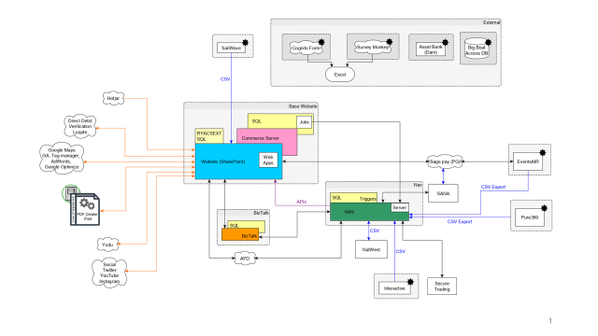
Current set up
Evolved vs. designed …
… making it ‘buggy’ and hard to maintain
Lots of customisation
End of life issues
Not capable of delivering the digital ambition – this isn’t an experience platform
Notes:
15,000 pages of content

Slide 11
We have been working with digital specialists Isobar to explore the options for implementing an experience platform
The digital basics enablers
The ‘ceiling raisers’
1. Governance, guidelines, process and ways of working
3. Digital ‘ecosystem’ strategy
Isobar and Sitecore XP
3 week ‘pre-discovery’
Requirements
Best fit solution
Creative
Roadmap
2. Segmentation, audiences and journeys
4. Measurement and optimisation

Slide 12
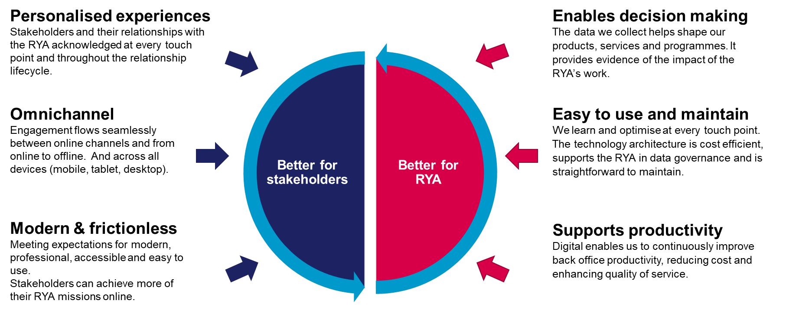
We looked at platforms (and partners) that could deliver the digital ambition, and support all the features and services that we host today
Digital ambition – building essential capability
Features and services – more resilient, better experience, less customisation
Events booking
Squad management
Hotel booking
Certificates
Membership join and management
News
Sail numbers and boat reg
Advice and knowledge (exclusive to members)
Locked areas for Clubs, Instructors and Training Centres
Shop – that can handle restricted content (B2C & B2B)
Notes:
Yet delivering against the ambition that we’ll use digital to make things better for stakeholders and they way we deliver at the RYA

Slide 13
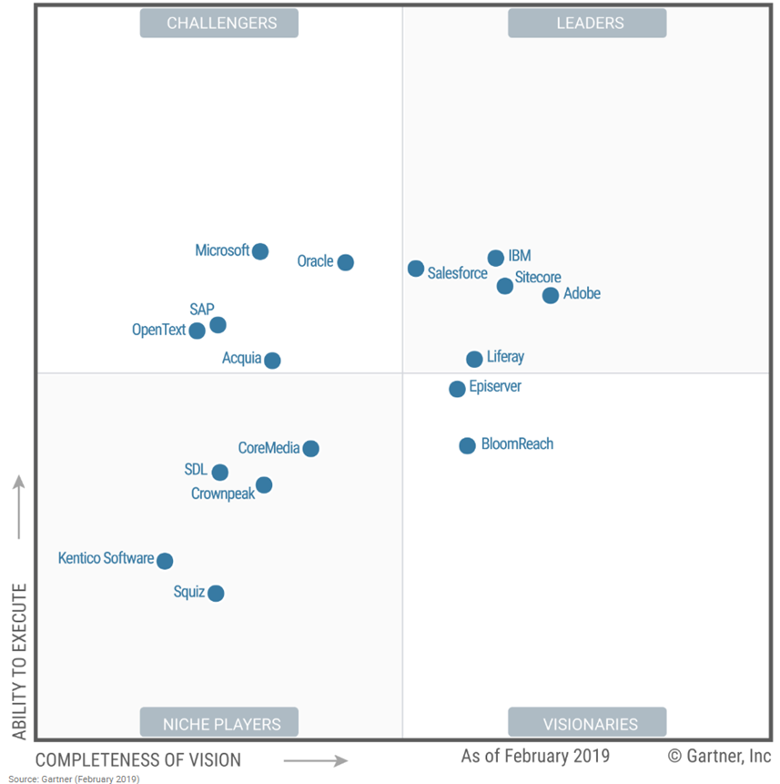
We reviewed the current technology landscape and shortlisted two experience platforms
Gartner ‘magic quadrant’
Adobe
IBM Watson
Episerver
Sitecore
Over-scaled for RYA needs
Best for personalisation, most capable ‘mid market’ solution

Slide 14
Why Sitecore XP?
Precision personalisation
Captures data with every interaction. Uses machine learning to personalise interactions. Drives logical user journeys.
Content management
Easy to plan, create, store, distribute and publish across all channels
Integrations
Ability to create ‘best fit solution from plug in tools’.
Ability to integrate with MS Nav

Slide 15
We’ve chosen a hybrid ‘best fit’ route
MS Nav
Shop
Sitecore framework at the centre.
Best fit specialist technologies integrated for shop, events booking, asset management and campaign capability.
Only custom build when it’s the absolute best option.
Sitecore XP
Digital Asset Management
Events / bookings
Email, SMS, Social comms
Notes:
The three criteria for selection are license/running costs;features; and enablement of RYA's engagement and experience personalisation goals.
▪In case of hotel requirements and events booking we recommend exploring EventsAir
▪The following have also been highlighted as potential areas for further evaluation:
–Ucommerceas the plugin for webshop/commerce
–Pure360 vs SiteCore’semail service
–AFD vs Loqateas there is overlap
–Digital Asset Management provider selection
–Long-term integration strategy

Slide 16
5 Year Digital Tech Roadmap overview
Year 1 FY19/20
Year 2 FY20/21
Year 3 FY21/22
Year 4 FY22/23
Year 5 FY23/24
Digital Basics implementation
Q1 & Q2 FY19/20
Preparation for raising the ceiling
Q3 FY19/20
Creative Review & Definition Business Process Refinement
Q3 FY19/20
Build technology foundations
Q4 FY20/21
New site live without personalisation
Q4 FY20/21
Rule based personalisation & responsive pages
Q3 FY21/22
Advanced personalisation using AI and machine learning

Slide 17
Implementation overview

Slide 18
High level cost overview
One off project costs:
MVP ~£820K
Rules based personalisation ~£248K-£448K
One off implementation project costs: MVP
Continued development of features:
Ongoing hosting, licence and maintenance costs:
Periodic costs of platform upgrade
RYA web team costs:
c£30-50k per annum (comparable to today)
c.£50-70k higher (smoothing peaks)
By investing in a support contract we’ll eliminate one off upgrade ‘shocks’
Less legacy technology to fix means we’ll improve the quality and productivity of service

Slide 19
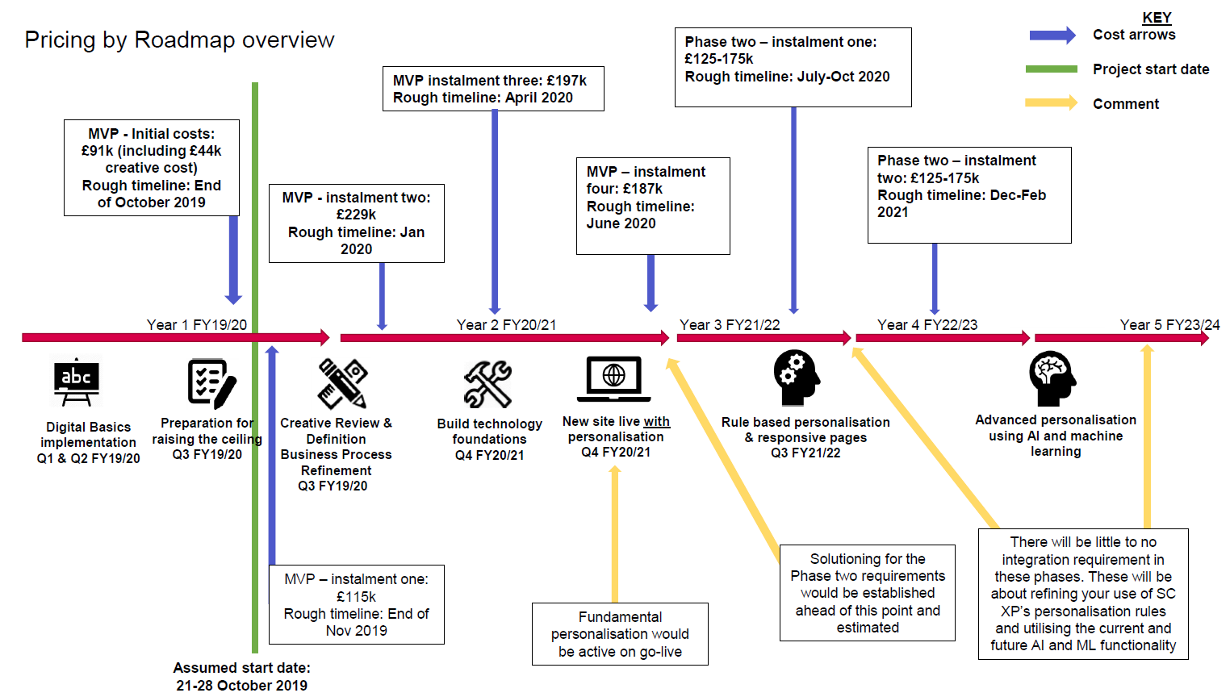
Approximate phasing. Not final.
*
* MVP = Minimum viable product

Slide 20
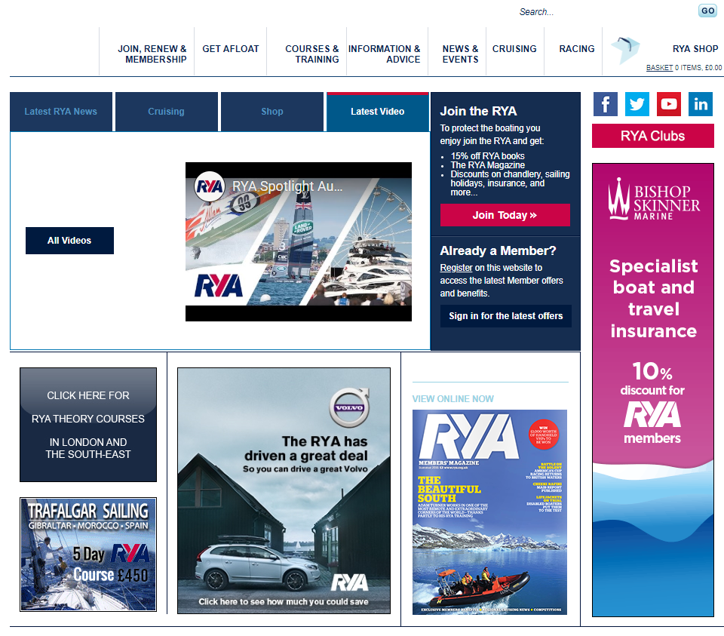
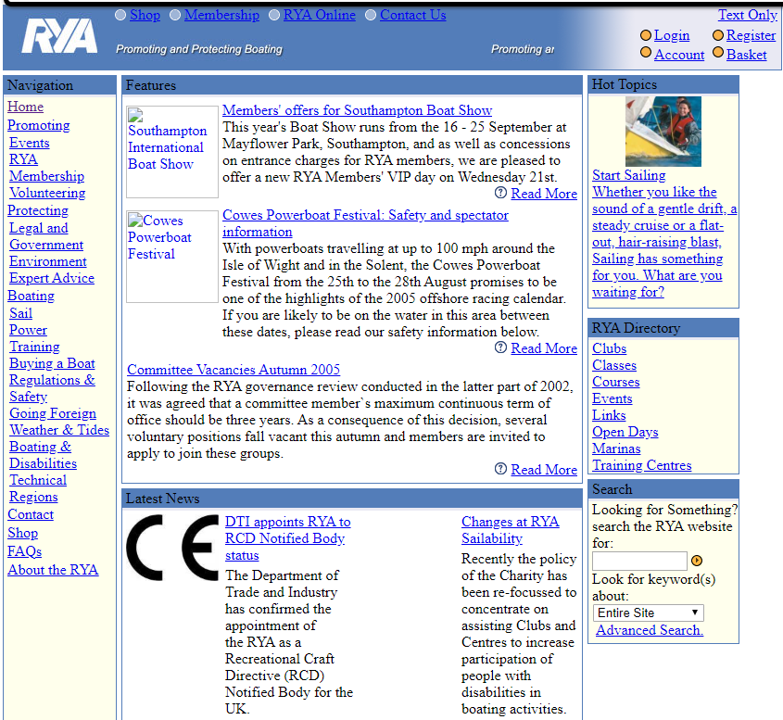
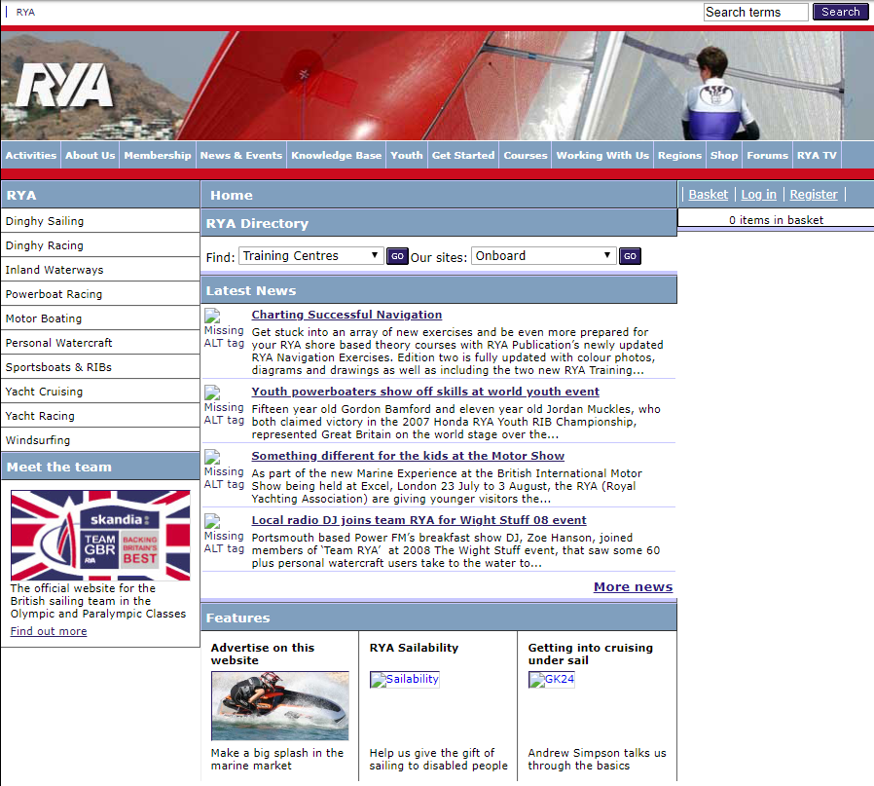
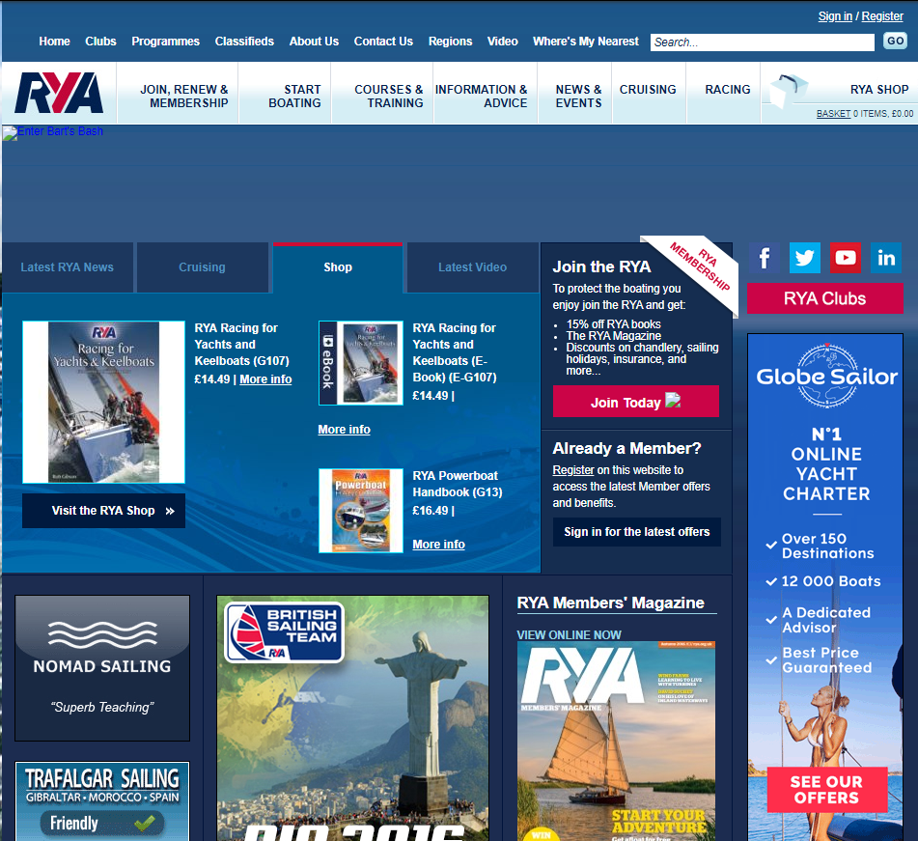
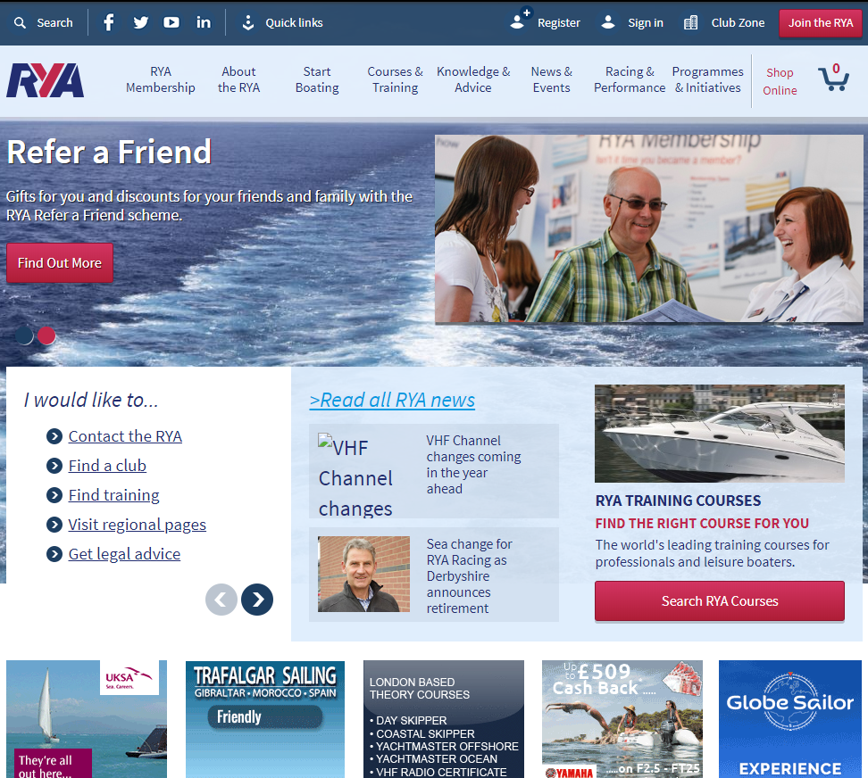
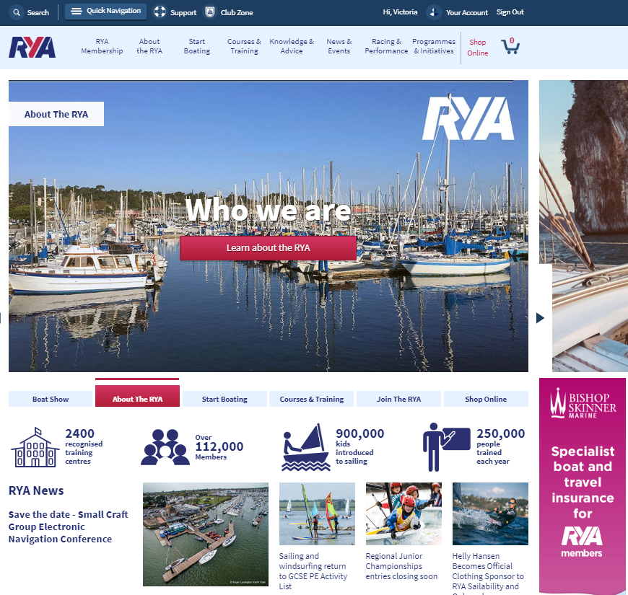
2005
2008
2011
2014
2016
2018
Today
Next?

