Slide 1
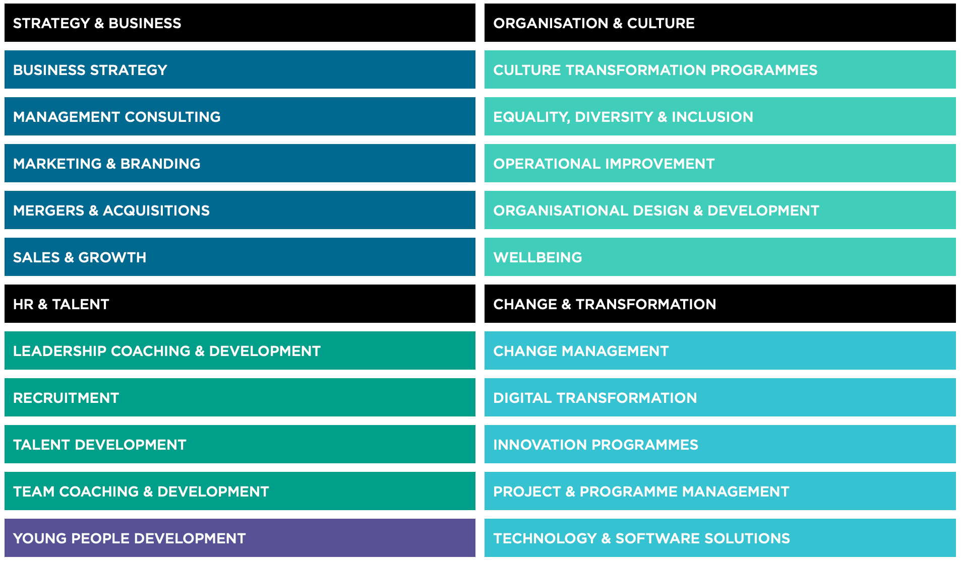
BUSINESS AREAS

